Slide 1
Multiple Pages with React Router

Slide 2


React Router?
So far, our app is essentially one long page. In this lesson, we’ll make it feel like a real application with navigation:
For example, when someone selects Explore, React displays the Explore page. For doing this, we need to use React Router.
Install React Router
  Open your VS Code terminal inside your project folder, type

Slide 3
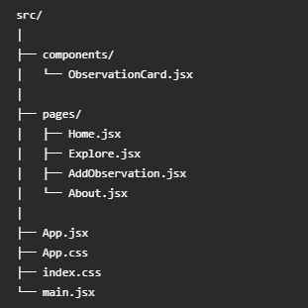
Create a pages folder
Create a “pages” folder in “src” folder,
And create 4 files Home.jsx, Explore.jsx, AddObservation.jsx, and About.jsx. Each .jsx file is for a page.
Each page is simply another React component.
The folder tree should look like this:

Slide 4
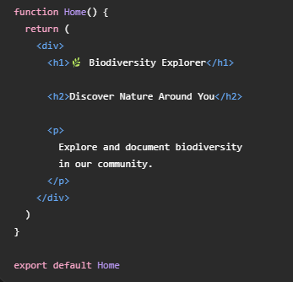
Create the Home page
In Home.jsx, enter:

Slide 5
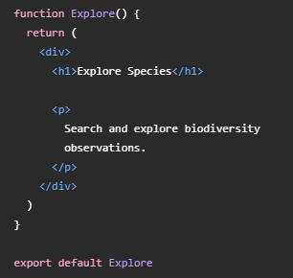
Create the Explore page
In Explore.jsx, enter:

Slide 6
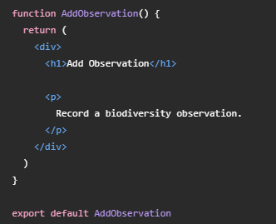
Create the Add Observation page
In AddObservation.jsx, enter:

Slide 7
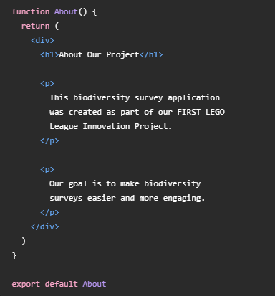
Create the About page
In About.jsx, enter:

Slide 8
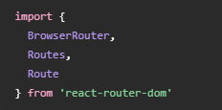

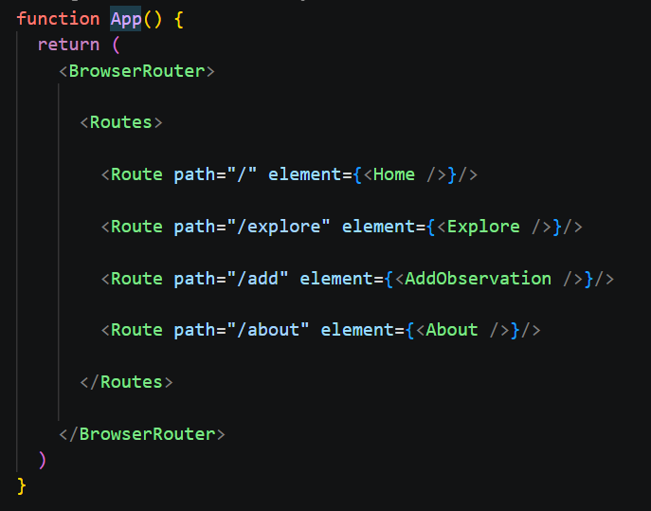
Set up React Router
Open App.jsx. Import:
Then import your pages:
Now write:

Slide 9
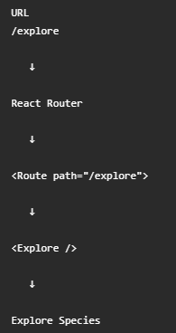
Understand <Route>
Look at:
It means:
  If the browser’s path is /explore, display the <Explore /> component.
Conceptually:

Slide 10
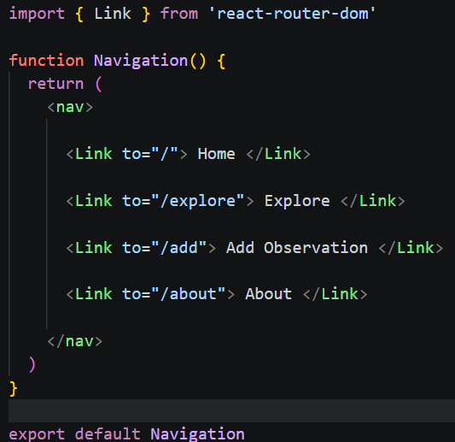
Create a Navigation component
Create Navigation.jsx in the folder src/components.
Add

Slide 11
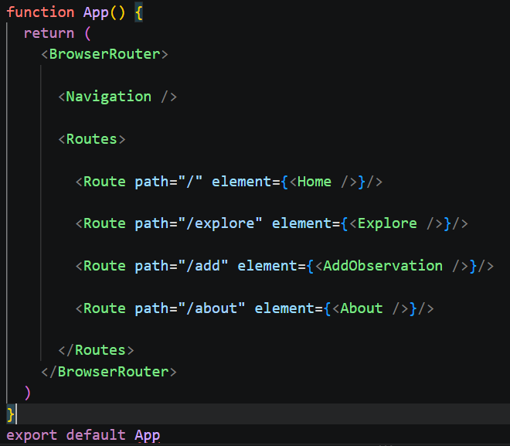
Add Navigation to App
In App.jsx, import Navigation:
Then in HTML section, add <Navigation />

Slide 12
More work
Style the navigation. See attached App.css
Move observations to Explore page. See attached Expore.jsx
Move the form to Add Observation page. See attached AddObservation.jsx
App.jsx update. See attached.

